Slide 1
Predictive Analysis
Notes:
Hello and welcome to module 5 of the data mining track!
Today we will be exploring the topic of Predictive Analysis!

Slide 2

Module 5 Instructor
Eric Cui
Dual Degree: MD / PSM BMHI
University of North Carolina at Chapel Hill
Office hours
Notes:
My name is Eric Cui and I will be your instructor for this module.
You may recognize me from module 2, Univariate analysis.
I am a dual degree student at UNC Chapel Hill. I am pursuing an MD from the UNC school of medicine and have finished my second year.
I am also pursuing a master’s degree in biomedical and health informatics.
There will be pre-specified office hours held this summer where you can speak to me via video call.
Now lets jump right in!

Slide 3
What is Predictive Analysis?
A branch of analytics which uses past data to understand and predict possible future outcomes
Ie. Netflix predicting which movies you will watch next and recommending those to you
Machine Learning is a type of Predictive Analysis
Notes:
So, what is predictive analysis and why is there so much hype around it?
Predictive analysis is simply a branch of analytics which attempts to….predict things!
The key feature of predictive analysis is that it attempts to use past data to make future predictions.
This is a powerful branch of analytics with many applications. Examples include Netflix trying to predict which movies you will watch and recommending those to you.
You may have also heard the term machine learning thrown out quite a bit these days. Machine learning is a type of predictive analysis.

Slide 4
What is Machine Learning?
Machine learning are algorithms which enable computers to learn from data and improve based upon that data without being explicitly programmed to do so.
Require two sets of data to work:
Training data: Data the computers learns from
Test data: Data the computer is evaluated on
We will be exploring two type of machine learning algorithms:
Logistic Regression
Decision Trees
Notes:
Diving deeper, what is machine learning?
Well, machine learning is a set of algorithms which allow the computer to quote-unquote learn using past data and using that learning to improve how well they make prediction on non-learning data without being explicitly designed to do so.
The key here is that machines can now make prediction on data they were not explicitly programmed to
In order to work, machine learning requires two sets of data, training data and test data.
Training data is the data that machine learning uses to learn form and improve itself
The test data allows us to see how well a machine learning algorithm is performing. This allows us to evaluate how well the algorithm learned using the training data.
We will be exploring two type of machine learning algorithms in this module, logistic regression and decision trees

Slide 5
End of Video 1

Slide 6
Predictive Analysis: Logistic Regression
Notes:
We will now be exploring our first predictive model. Logistic Regression

Slide 7
What is Logistic Regression?
Classification algorithm designed to assign observations to a discrete or limited number of classes
Ie. Email spam vs. not spam
Types of Logistic Regression:
Binary (Malignant vs. Benign Tumor)
Multi-class (Which cancer stage? Stage 1 vs 2 vs 3 vs 4)
This module will focus on Binary Logistic Regression
Notes:
What is logistic regression? Logistic regression is an algorithm designed to classify or predict some kind of observation in a limited number of possible predictions or categories.
One example of this is your email predicting if an email is spam or not spam. In this case there are only two possible categories.
There are many kinds of logistic regression.
The first kind is binary logistic regression. This is predicting with only two categories. An example would be predicting if a tumor it benign or malignant.
The second kind is multi-class logistic regression. This is predicting with more than two categories. An example would be predicting what stage a cancer is. Stage 1? Stage 2? And so on…
This module will be exclusively focusing on binary logistic regression

Slide 8
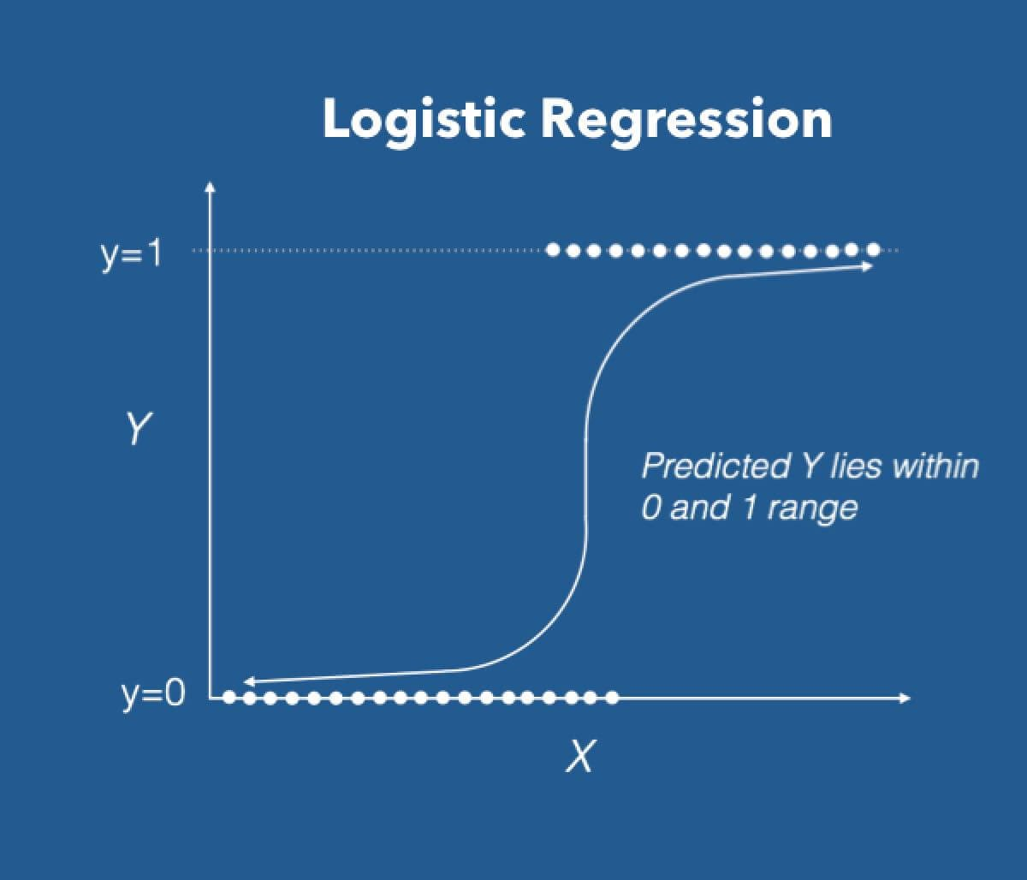
How Does Logistic Regression Work?
Calculates a probability for a particular prediction class using a ‘sigmoid’ or ‘logit’ function
Sigmoid simply means “S-shaped”. This is the shape of the sigmoid function.
Will ‘ingest’ all variables given to it in the data and compute a probability based on those variables
Notes:
How does logistic regression work? Well, as we covered, logistic regression make a prediction out of a limited number of categories. How does it make this prediction? It does so through assigning probabilities for the different possible categories or prediction. Now how does logistic regression arrive at these predictions?
It does so though a “sigmoid” or “logit” function. An example of one is shown on the image.
Sigmoid simply means “S-shaped”. This refers to the shape of the function shown in the image.
What is happening is that a logistic regression model is ingesting or taking in all observations and variables presented to it in the data, and then computing a prediction probability using that data. This prediction is made using a “sigmoid” or “logit” function.

Slide 9
Important Note
Many online resources will delve deep into the math behind logistic regression
For the purpose of this module, you just need to understand that logistic regression will classify an observation to a discrete number of categories
The math behind logistic regression is beyond the scope of this module
Notes:
Now, I understand the last slide may have been dense with a lot of technical term thrown about.
I want to emphasize that the focus for this module is on the big picture.
Many online resources will delve deep into the math behind logistic regression
For the purposes of this module, you just need to understand that logistic regression will classify an observation based on a limited or discrete number of categories
The math behind the logit function or logistic regression is beyond the scope of this module

Slide 10
Advantages vs. Disadvantages
Advantages:
Simple (compared to other algorithms)
Not resource intensive (computer can quickly make a prediction)
Disadvantages:
Not as powerful as more complex algorithms
Assumes two classes can be classified linearly
Notes:
Now, why would you use logistic regression?
Well, it’s a simple algorithm compared to some of the others you could use in machine learning.
It is also not resource intensive. What this means is that computers can quickly make prediction on a lot of data. More complicated algorithms may take much longer to make those predictions for the same amount of data.
Now what are the disadvantages?
As stated earlier, logistic regression is a simple algorithm compared to others. This means it may not be as powerful or accurate as other prediction algorithms available.
In addition, it assumes that two classes or prediction can be teased out separately based on a linear relationship. What the heck does this mean?

Slide 11
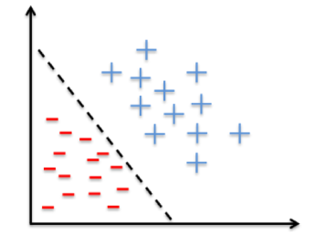
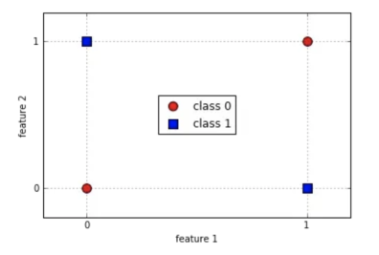
Logistic Regression is Meant to Solve Linear Problems
Notes:
Look at the two chart above. The goal in these two charts is to separate the red points from the blue points using a straight line.
If you look on the right, the points can be easily separated by a straight line. However, in the chart on the left, it is impossible to separate the points by a straight line. Go ahead, try to separate the blue and red points using a straight line.
This means that the data in the left is a non-linear problem while the data on the right is a linear problem. Going back to our last slide, we said that one of the disadvantages of logistic regression is that it assumes data can separated linearly. This may not necessarily be the case.

Slide 12
End of Video 2

Slide 13
Exercise 1
Which of the problems below could be a logistic regression classifier be used for?
Predicting whether a patient with be readmitted or not
Predicting a diabetic patients blood sugar value
Predicting whether someone will have a heart attack
Predicting whether a patient will show up to their appointment

Slide 14
Exercise 2
Our module is looking at whether a patient dies during their first 24 hours. Can a logistic regression classifier be applied to this problem?
Yes
No

Slide 15
Predictive Analysis: Decision Trees
Notes:
Our next predictive model we will cover are decision trees.

Slide 16
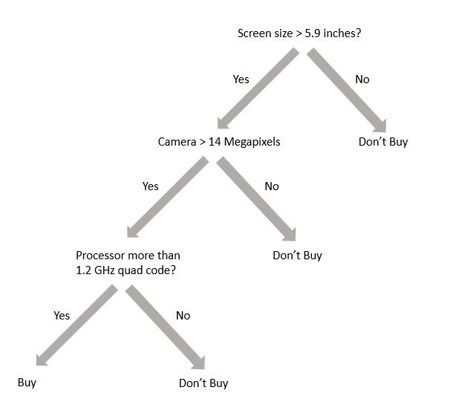
What are Decision Trees?
Decision trees are a flow-chart like structure to make complex decisions
Each branch or split in the tree is a decision based on a variable
Notes:
Decision tress make predictions using a flow-chart like structure or logic. It is very useful for breaking down a decision in detail. For instance, the decision tree display on the slide is a decision tree to determine whether or not to buy a phone.
In the context of data analytics, each split or “branch” is a decision based on information provided by a single variable.

Slide 17
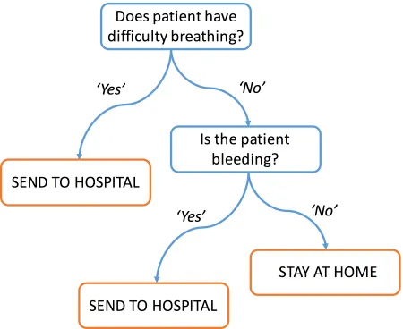
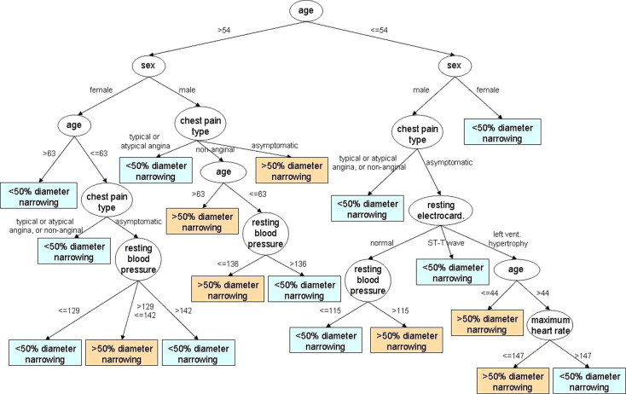
Decision Trees Are Common in Healthcare
Notes:
Decision trees are commonly used in medicine, they can be both simple and complex. The one on the left is a simple decision tree for determining whether a patient should stay home or be sent to the hospital based on if they have difficulty breathing or are bleeding. The decision tree on the right illustrates a complex tree for helping a medical provider determine if a patient’s arteries are more or less than 50% occluded or narrowed.
In the past, decision trees were manually created by people. However, in machine learning, decision trees are automatically created using past data. Computers can quickly create incredibly complex trees in seconds.

Slide 18
Regression and Classification Trees
Unlike logistic regression, decision trees can predict both numerical values (regression trees) and predictions with a discrete number of categories (classification trees)
We will be focusing on classification trees
Notes:
Unlike logistic regression, decision trees are more flexible in their predictions. They can predict both numerical values, which are called regression trees, and predictions that only have a discrete number of categories, which are called classification trees. This module will be focusing exclusively on classification trees.

Slide 19
Decision Tree Examples
Notes:
Lets revisit the simple decision tree we saw earlier about whether to send a patient home or to the hospital and recap. As we mentioned a decision tree can be classification or a regression tree. In this case, this is a classification tree because there are only two possible predictions/outcomes, stay at home or send to hospital.
In addition, each branch or split is based on a single variable. For instance, the first split is whether a patient has difficulty breathing. This would be it’s own variable in a dataset and this variable would tell us whether a specific patient was having difficulty breathing or not.

Slide 20
Advantages vs. Disadvantages
Advantages
Simple
Intuitive
Easy to explain
Disadvantages
Slower to train
Can have overly complex trees
Small changes can lead to large differences in tree structure
Notes:
Now decision trees have many advantages. Once again they are relatively simple compared to other algorithms. In addition, they are both intuitive and easy to explain. That is because you can visualize each decision tree and see how a computer created it’s tree or branches. This makes it easier to understand.
However, there are several disadvantages. First, creating a viable tree can be resource intensive and slow process for a computer. In addition, computers can create hugely complex trees. While you may be able to understand a tree like this with time, unnecessarily complex tree are not very good for general use. In addition, small changes in your data can lead to huge and inexplicable differences in how a computer constructs its tree. This may hurt how applicable your tree is for general situations/predictions.

Slide 21
End of Video 3

Slide 22
Exercise
Is this a regression tree or classification tree?

Slide 23
Exercise
For our module we will be determining if patients die within the first 24 hours. What kind of tree should we use to make this prediction?
Regression Tree
Classification Tree

Slide 24
Predictive Analysis: Evaluation
Notes:
Now that we have learned how about a few model, we will learn how to evaluate a model’s performance.

Slide 25
Evaluation: Sensitivity, Specificity, and ROC Curves
Evaluation is critical for predictive analysis
Evaluating models is how we can determine which approach is better
We will cover four evaluation metrics in this module:
Accuracy
Sensitivity
Specificity
Receiver Operating Characteristics (ROC) Curves
Notes:
Evaluation is one of the most important if not the most important part of predictive analysis.
How do we determine which model is better than another for a certain job? The answer is evaluation.
We will examine four evaluation metrics in this module: Accuracy, sensitivity, and specificity

Slide 26
Confusion Matrix
Confusion Matrix – a table used to describe or evaluate the performance of a machine learning model
2x2 table plotting combination of predicted and actual values
Notes:
To calculate our metrics, we need to create something called a confusion matrix. This is simple a 2x2 table which plots the predicted against the actual values predicted by a machine learning algorithm.
This table is critical for evaluating a machine learning model.

Slide 27
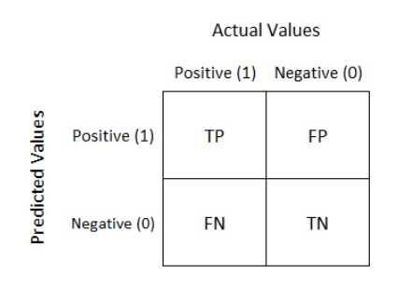
Confusion Matrix (cont.)
True Positive (TP) – Correct Positive Prediction
True Negative (TN) – Correct Negative Prediction
False Positive (FP) – Incorrect Negative Prediction
False Negative (FN) – Incorrect Negative Prediction
Notes:
Now here we can see an example of a confusion matrix. Pretend we are evaluating a medical test for a disease which can give a positive or negative result. The model will attempt to make predictions about whether the test will be positive or negative .However, not all of those prediction will be accurate. This table will capture all possible scenarios.
The top labels of the confusion matrix represents whether a patient is actually positive or negative for a disease
The labels on the left of the confusion matrix represents whether a patient is predicted to be positive or negative for a disease.
In the top left, these are the value that the model predicted to be positive and that were actually positive in the data. We refer to these as true positive.
In the bottom right, these are values that the model predicted to be negative and that were actually negative in the data. We refer to these as true negatives.
In the top right, these are values that the model predicted to be positive that were actually negative. We refer to these as false positives
Finally, in the bottom left, these are values that the model predicted to be negative that were actually positive. We refer to these as false negatives.
Now, that was quite a bit of information. I recommend you rewatch this section of the video again if you are still feeling uncertain about these concepts. Understanding evaluation is critical for predictive analysis.

Slide 28

Confusion Matrix Example
Say you are trying to predict whether patients actually have a disease
Say 100 people are correctly predicted to have the disease. How would you fill in the table?
 |  | Actual Disease Status
 |  | No Disease | Has Disease
Predicted Disease Status | No Disease
 | Has Disease
Notes:
So, let look at the previous concepts with an example. Say you are trying to predict whether patients actually have a disease using a machine learning model. Say 100 people are correctly predicted to have the disease. How would you fill the table?
This would mean that we 100 true negatives. One important note, negative and positive do not have any specific connotations in machine learning. Positive simply means that the result we are looking for is there. In this case that means we have detected an absence of disease. Negative simple means that the result we are looking for is not there. In this case that means we do NOT detect an absence of disease.

Slide 29
Confusion Matrix Example (cont.)
Say you are trying to predict whether patients actually have a disease
Say 10 people are incorrectly predicted to not have the disease. How would you fill in the table?
 |  | Actual Disease Status
 |  | No Disease | Has Disease
Predicted Disease Status | No Disease
 | Has Disease |  | 100
Notes:
Lets continue, say 10 people are incorrectly predicted to have the disease. How would you fill the table?
This means that 10 people have false positive results.

Slide 30
Confusion Matrix Example (cont.)
Say you are trying to predict whether patients actually have a disease
Say 50 people are correctly predicted to not have the disease. How would you fill in the table?
 |  | Actual Disease Status
 |  | No Disease | Has Disease
Predicted Disease Status | No Disease |  | 10
 | Has Disease |  | 100
Notes:
Lets say 50 people are correctly predicted to not have the disease. How would you fill the table?
This means 50 people have true positive results.

Slide 31

Confusion Matrix Example (cont.)
Say you are trying to predict whether patients actually have a disease
Say 5 people are incorrectly predicted to have the disease. How would you fill in the table?
 |  | Actual Disease Status
 |  | No Disease | Has Disease
Predicted Disease Status | No Disease | 50 | 10
 | Has Disease |  | 100
Notes:
Finally, say 5 people are incorrectly predicted to have the disease. How would you fill the table?\
This means 5 people have false negative results.

Slide 32
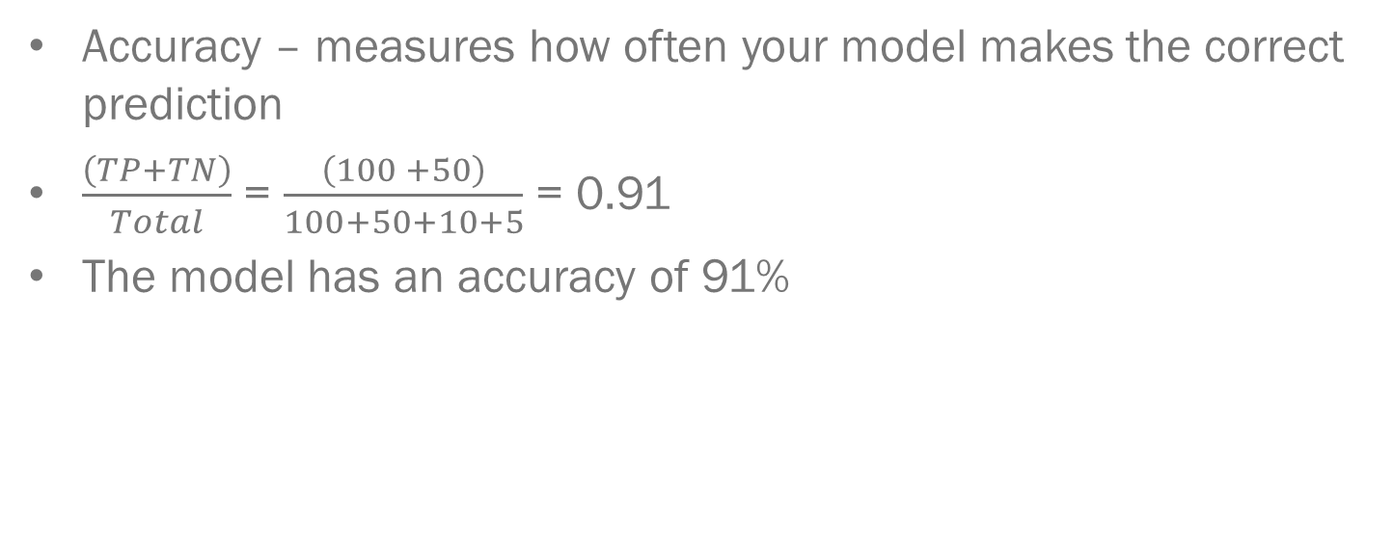
Accuracy
Accuracy – measures how often your model makes the correct prediction
$\frac{\left(TP+TN\right)}{Total}$ = $\frac{\left(100 +50\right)}{100+50+10+5}$ = 0.91
The model has an accuracy of 91%
 |  | Actual Disease Status
 |  | No Disease | Has Disease
Predicted Disease Status | No Disease | 50 | 10
 | Has Disease | 5 | 100
Notes:
Now that we understand what a confusion matrix is, we can begin to learn about specific metrics. The first is accuracy. This simply measure how often your model makes the correct prediction.
Accuracy are your correct predictions (true positive and true negative) divided by your total. In the previous example that would be 91% then.

Slide 33
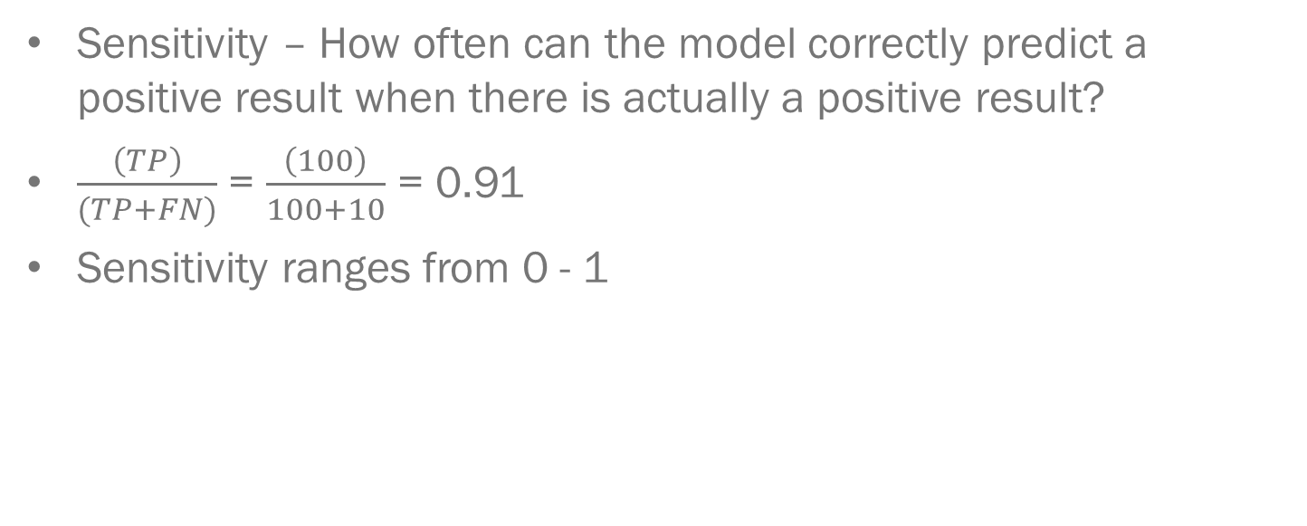
Sensitivity
Sensitivity – How often can the model correctly predict a positive result when there is actually a positive result?
$\frac{\left(TP\right)}{(TP+FN)}$ = $\frac{\left(100\right)}{100+10}$ = 0.91
Sensitivity ranges from 0 - 1
 |  | Actual Disease Status
 |  | No Disease | Has Disease
Predicted Disease Status | No Disease | 50 | 10
 | Has Disease | 5 | 100
Notes:
Our next measure is sensitivity. Sensitivity tells us how often does the model correctly predict a positive result when there is actually a positive result?
Sensitivity can be calculated by taking the number of correct positive predictions (true positive) divided by the sum of the correct positive predictions (true positive) and the incorrect predictions which were actually positive (False Negative).
In our example the sensitivity is 0.91. Sensitivity ranges from 0 to 1. The closer it is to 1, the better the model is.

Slide 34
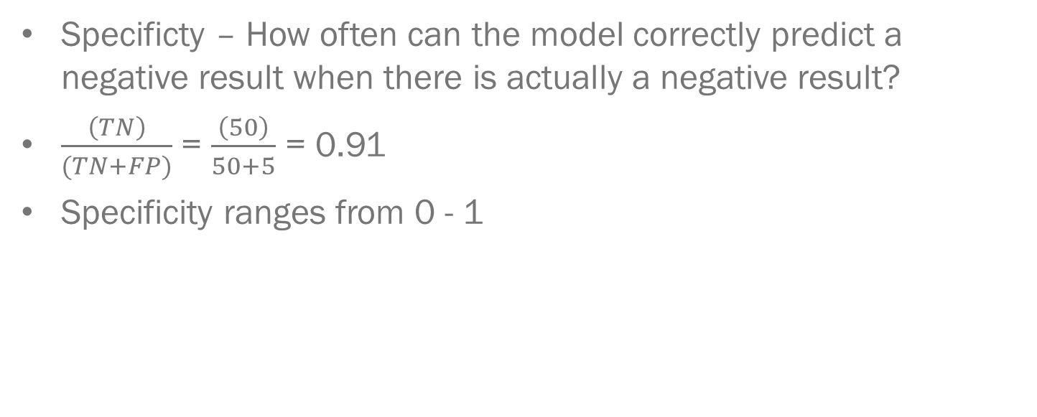
Specificity
Specificty – How often can the model correctly predict a negative result when there is actually a negative result?
$\frac{\left(TN\right)}{(TN+FP)}$ = $\frac{\left(50\right)}{50+5}$ = 0.91
Specificity ranges from 0 - 1
 |  | Actual Disease Status
 |  | No Disease | Has Disease
Predicted Disease Status | No Disease | 50 | 10
 | Has Disease | 5 | 100
Notes:
Our next measure is sensitivity. Specificity tells us how often does the model correctly predict a negative result when there is actually a negative result?
Specificity can be calculated by taking the number of correct negative predictions (true negative) divided by the sum of the correct negative predictions (true negative) and the incorrect predictions which were actually negative (False Positive).
In our example the specificity is 0.91. Specificty ranges from 0 to 1. The closer it is to 1, the better the model is.

Slide 35
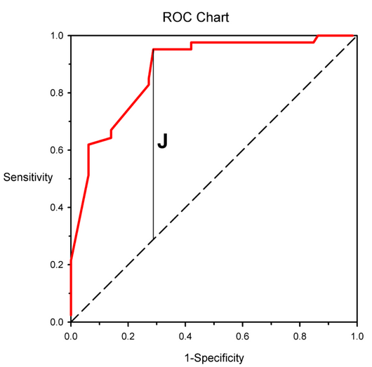
Receiver Operating Characteristics (ROC) Curves
A visual way to evaluate the performance of a model taking into account both sensitivity and specificity!
Notes:
Our last metric we will be looking at are receiver operating characteristic curves or ROC curves. This is a visual way to evaluate a model performance taking into account both sensitivity and specificity. The y axis of the curve is sensitivity and x axis is 1 – specificity. The ROC curve allows us to get a picture of OVERALL model performance

Slide 36
Receiver Operating Characteristics (ROC) Curves (Cont.)
The closer to the top left that the classifier is, the better its performance
Dashed line in the middle is the same as 50-50 guessing
Notes:
The closer that an ROC curve is to the top left corner of a graph, the better it’s overall prediction performance. You may have noticed the dashed line in the image. This represents the equivalent of the model was only as good as flipping a coin or 50-50 guessing. Anything above the dashed line is better than random chance. Anything below the dashed line is worse than random chance.

Slide 37
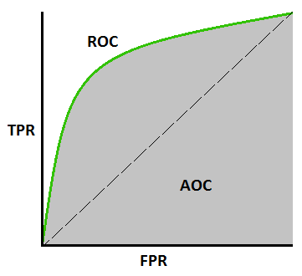
Area Under the Curve (AUC)
The area under the curve (AUC) of an ROC curve will give us a quantitative measure about how well the model performs
Ranges from 0 - 1
Higher the AUC value, the better the predictive ability
Dashed line in the middle has an AUC value of 0.5
Notes:
So, since ROC curves are visual, how can we compare two different curves against each other? We can use a measure called area under the curve. By measure the area under an ROC curve, we can get a quantitative measure of ROC. The higher an AUC value is, the better model performs. AUC values range from 0 to 1.
For reference, the dashed line in the middle has an AUC value of 0.5

Slide 38




We are grateful to the following organizations for their support:
Notes:
We would like to take a moment and thank the following organization for their support. These module would not be possible without their support.

Slide 39
Interested in an MPS or a Ph.D. in digital health? Drop us a line: chip@unc.edu.
Notes:
Finally, are you interested further in health analytics or digital medicine? Consider a graduate degree for the University of North Carolina Carolina Health Informatics Program!

Slide 40
End of Video 4

Slide 41
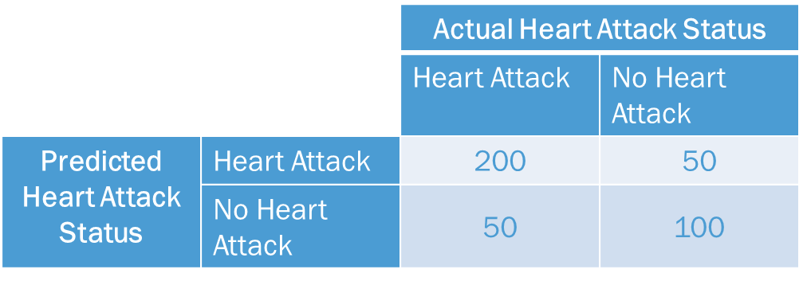
Exercise
Imagine you have created a model to predict whether a patient will have a heart attack or not. You run an evaluation and obtain the following confusion matrix
Please calculate the accuracy, specificity, and sensitivity

Slide 42
Exercise
Imagine you have two prediction model
One has an accuracy of 95% and an ROC-AUC of 0.60
Another one has accuracy of 86% and an ROC-AUC of 0.75
Which is the better model?

